Slide 1

Sentiment and Skepticism of tweets referencing global warming
IMSE 670 Final Project
Wesley Matson

Slide 2
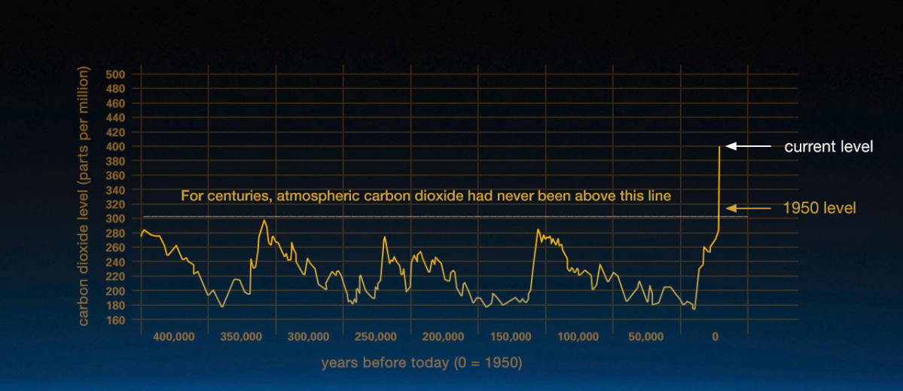
Climate change is becoming an increasing polarizing political topic
Recent weather data has shown the earth is getting warmer at an increasing pace.
The scientific community is certain the affects are man made, while others are skeptical humanity can affect climate.
If human behavior is to blame, the time to act is now to reduce the damaging negative affects.

Slide 3
Will climate change be a bigger issue in the 2020 presidential election?
Collect tweets mentioning ‘climate change’ of ‘global warming’ from April 2019, April 2015 and April 2011.
Use VADER sentiment python package to measure the sentiment and label each tweet as positive, negative or neutral.
After manually labeling a small sample from each time period, use topic modeling package Neutral Network to label each tweet as skeptical or not skeptical of human induced climate change.
From this analysis, we can see if there are any potential shifts in voter sentiment

Slide 4
Sentiment analysis
Sentiment of tweets referencing ‘Climate Change’ is relatively unchanged in the last 8 years.

Slide 5
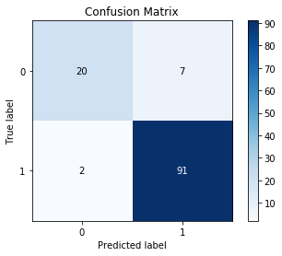
Topic Modeling to estimate skepticism
Estimated Model Accuracy:
How skepticism changed with time:
Clearly, skepticism of global warming has increased in the past 8 years

Slide 6
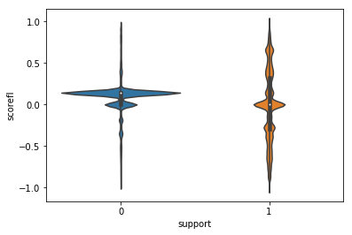
Connection between sentiment and skepticism
Distribution of sentiment in each skepticism category
Compare sentiment in each skepticism category

Slide 7
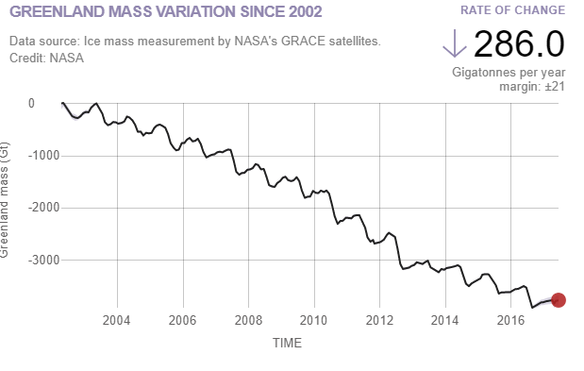
While sentiment of tweets remains unchanged, skepticism of tweets has increased.

